Slide 1

Super Store & Car Sale Survey With PowerBI and Python
By,
Shruti Ashish Vedpathak
Enrolment ID:EBEON0822636730
Batch: 2022-7799

Slide 2


INTRODUCTION
Dataset Identification and loading
Pre-processing
Analysing the dataset of superstore
Using PowerBI
Analysing the dataset of car sales
Using Python

Slide 3

DATASET IDENTIFICATION AND LOADING
LOAD DATASET
There are total 24 columns and 51291 rows in dataset. Furniture, Office Supplies and Technology are the categories for sale.
PRE-PROCESSING
Perform ETL i.e. Extract Transform and Load.
IDENTIFYING THE SALES
From the data modelling, It can be identified where the sales are lacking, which is the less sell product, who are the top customers or top brands etc.
Sort and Clean the data.
Data Modelling is done to relate the data elements

Slide 4

POWER BI REPORT
Sales Analysis Charts
Funnel Chart |Stacked Column Chart |PI Chart |Ribbon Chart |Tree Map |Line Chart |Cards

Slide 5
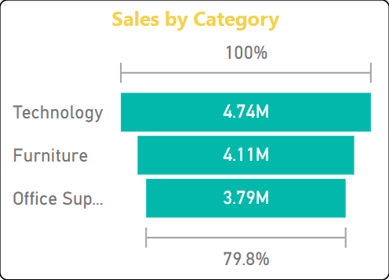
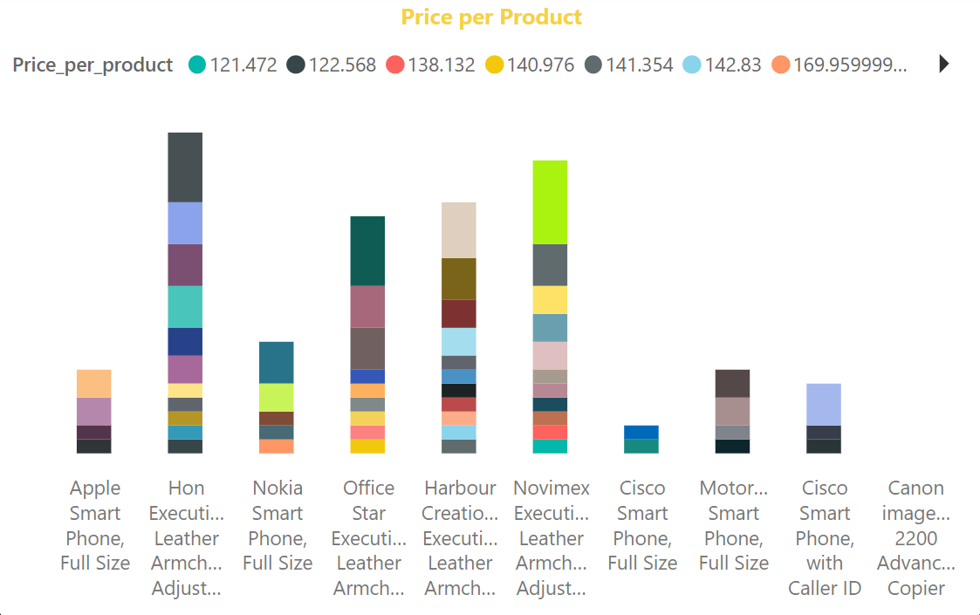
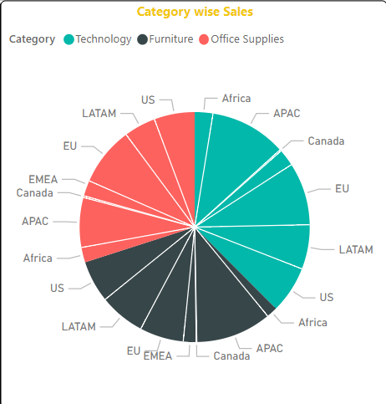
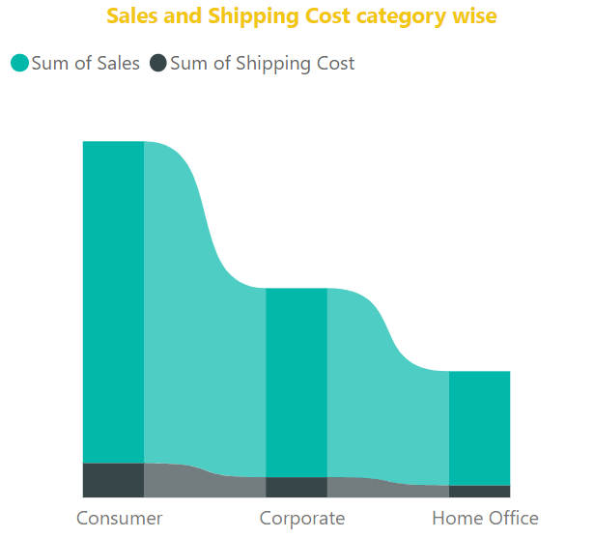
POWER BI REPORT
Funnel Chart
A funnel chart represents the sale of different categories. Here it can be identified in which category the sale is lacking
Stacked Column Chart
Stacked column chart shows the price of the products with different product ID.
PI Chart
PI chart gives the details of the category wise market and sales.
Ribbon Chart
Ribbon chart is used to represent the sum of sales and shipping cost for the category wise products

Slide 6
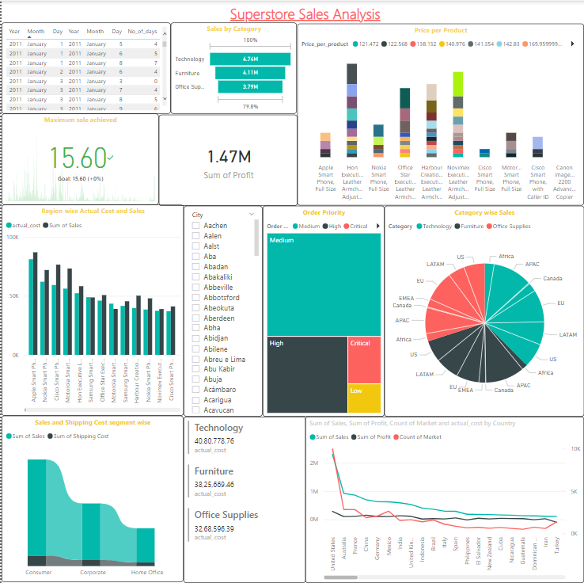
Slicer: is applied on cities so the data can be analysed for each city.
Cards: Two cards are used. One in the middle represent the sum pf profit and second multi card is used.
Line Chart: To represent sales and profit country wise line chart is used (Bottom right).
Tree Map: Order priorities are given with the help of tree map.
Clustered Column Chart: represents the actual cost and sale (Middle left side).
KPI: Maximum sale achieved is represented by the key performance index card (Left corner).

Slide 7

PYTHON PROGRAMMING
Using Jupyter Notebook Load dataset, analysis, visualization

Slide 8

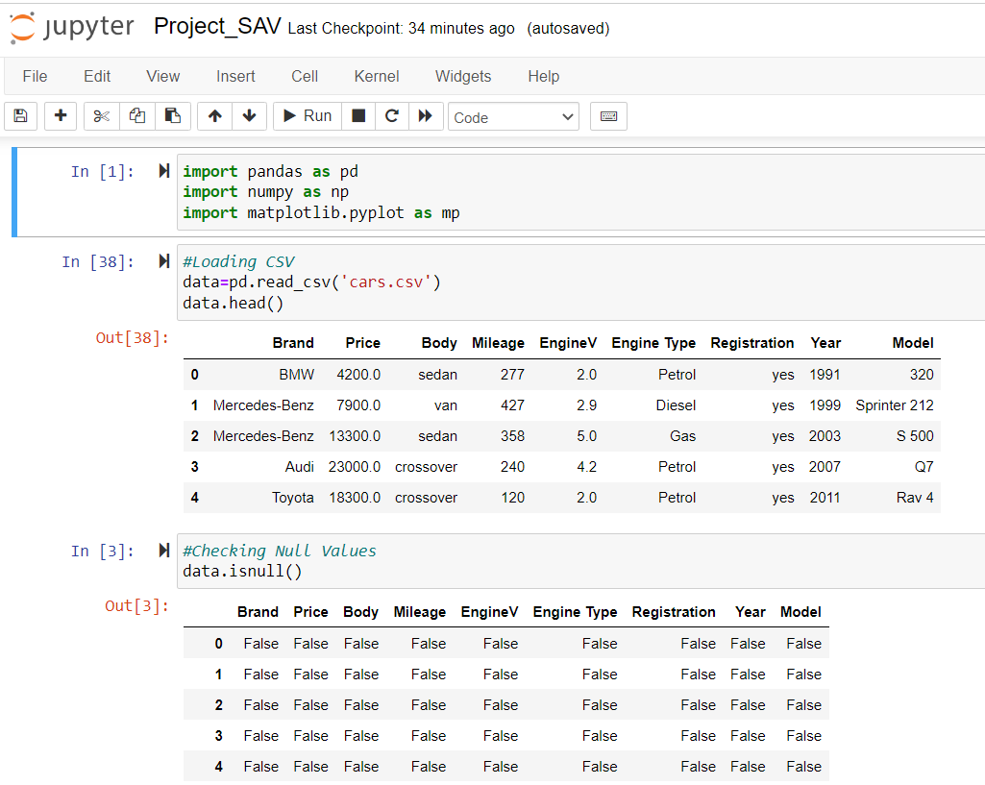

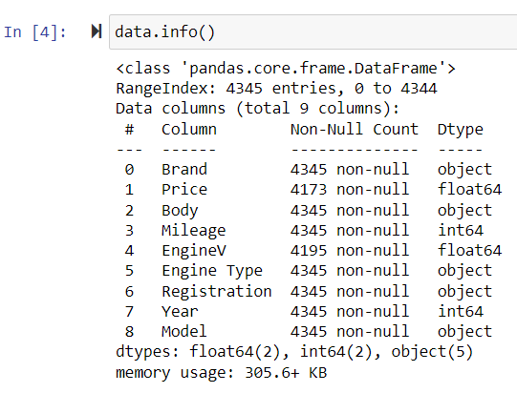
Load Dataset
Required Libraries
Pandas,
Numpy,
matplotlib.pyplot
Understanding Dataset
There are total 9 columns & 4345 rows.
Columns are Brand, Price, Body, Mileage, EngineV, Engine Type, etc.

Slide 9
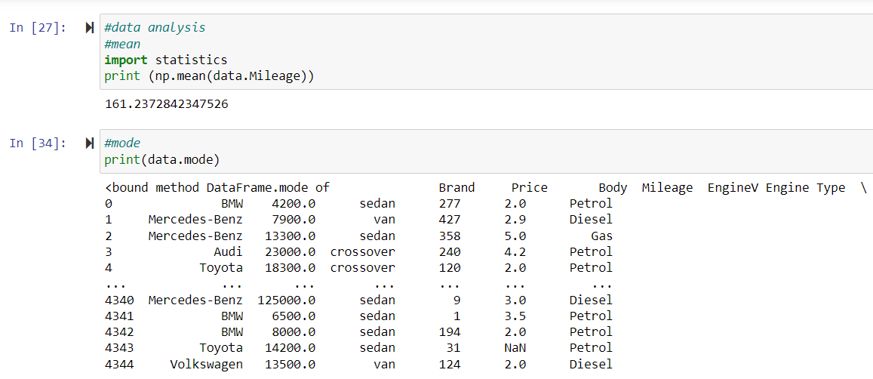
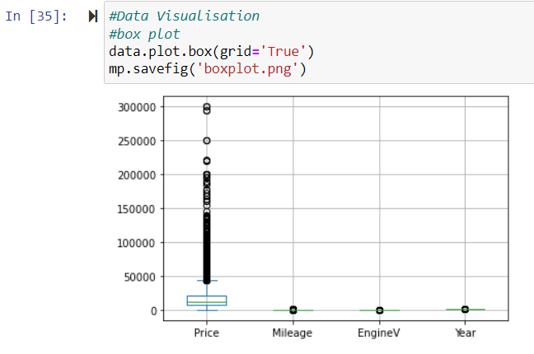
Data analysis is done by finding out mean, mode values for price, mileage etc.
Data Visualization is done using various graphs.
Boxplot represents the distribution of the data for each column

Slide 10
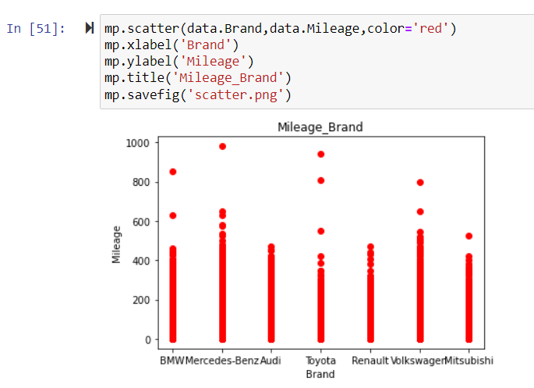
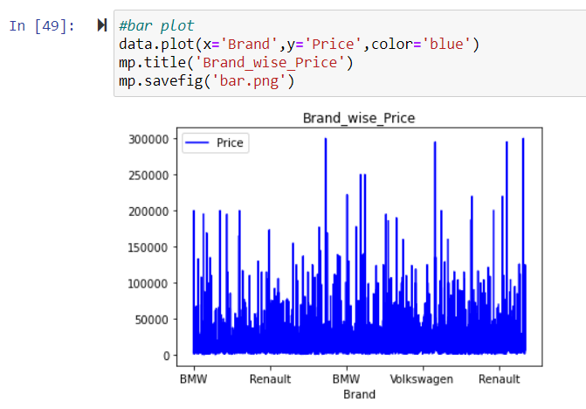
Scatter Plot is used to represent the mileage of the different brands of the cars
Bar Plot is used to represent the brand wise price of the cars

Slide 11
THANK YOU

